Slide 1
Scientific Computation and Data Visualization, Part 1
Link to this document
Applied Python

Slide 2
What are we doing?
Learning Objectives
By the end of this week, you should:
understand the purpose of scientific computation
identify features of a plot
know why data visualization is an excellent way to communicate
Measurable Outcomes
By the end of this week, you should be able to:
create an ndarray
create a figure with matplotlib and add subplots
modify the features of a subplot

Slide 3
SCIENTIFIC COMPUTATION

Slide 4
NumPy: Numeric Python
NumPy is a general-purpose array-processing package. It provides a high-performance multidimensional array objects, as well as tools for working with these arrays. It is the fundamental package for scientific computing with Python.
Besides its obvious scientific uses, NumPy can also be used as an efficient multi-dimensional container of generic data.

Slide 5
NumPy: wait but why?
It turns out that, while Python is awesome at a lot of things, there are some places where it is not very efficient. Specifically, it's not great with storage and manipulation of large sets of numbers.
You could choose to, for instance, hold a large data set in a list. But each item in that list has quite a lot more information, including header info, pointer info, et al. So generally, a similar number of entries in a Python list to a NumPy array will be on the order of 3 to 4 times larger.
You will get the same effective results with actual manipulation of those numbers. Multiplying two large equally-sized lists in Python is going to take significantly longer than multiplying two large equally-sized NumPy arrays.

Slide 6
NumPy: including
Including NumPy in your codebase is as easy as importing it. It is usually given a local name →
Don't forget that if you haven't used it in this particular project before, you'll need to install it first! NOTE: Ed Stem workspaces already have numpy installed
import numpy as np

Slide 7
NumPy: arrays
An array in NumPy is a table of elements (usually numbers), all of the same type, indexed by a tuple of positive integers. Technically the object type is called the ndarray, for n-dimensional array. The number of dimensions of the array is called the rank of the array.
Elements in NumPy arrays are accessed by using square brackets and can be initialized by using Python lists, but can also be created in a number of other ways.
import numpy as np
arr = np.array([1, 2, 3])
print("Array with Rank 1: \n", arr)
arr = np.array([[1, 2, 3], [4, 5, 6]])
print("Array with Rank 2: \n", arr)
arr = np.array((1, 3, 2))
print("\nArray created using tuple:\n", arr)

Slide 8
NumPy: datatypes
NumPy supports a significantly greater number of numeric datatypes than Python does. Each are specified by a type followed by the number of bits. These include but are not limited to:
int8, int16, int32, int64: signed integers e.g. int8: -127 to 128
uint8, uint16, uint32, uint64: unsigned integers e.g. uint8: 0 to 255
float16, float32, float64: floats e.g. float16: sign bit, 5 bits exponent, 10 bits mantissa
complex64, complex128: complex numbers e.g. complex64: two float32s (one real, one imaginary)
You can specify the datatype of the ndarray by passing the keyword argument dtype:
arr = np.ndarray([1, 2, 3], dtype = 'uint64') # 64-bit unsigned int

Slide 9
NumPy: creating and manipulating
Ndarrays in NumPy can be created in multiple ways, with various number of ranks defining the size of the array. For instance:
a = np.arange(8)
is the same as:
a = np.array(range(0, 8))
You can get the number of dimensions of an ndarray:
a.ndim
You can get the shape of the ndarray:
a.shape
and you can reshape the dimensions using:
a = a.reshape(x, y)

Slide 10
NumPy: selecting
As previously mentioned, ndarrays can be accessed in the same way as Python's built-in collections. To select from an array, you use a simple extension of standard python sequence selection syntax.
ndarr = np.array([[1, 2, 3], [4, 5, 6]])
print(ndarr)
print(ndarr[0]) # select 0th row
print(ndarr[0, 2]) # select 0th row 2nd column
>>> [[1 2 3]
[4 5 6]]
>>> [1 2 3]
>>> 3

Slide 11
NumPy: slicing
To slice an array, you have two options. The first is the slice() function, remembering that slicing follows start:stop:step format.
ndarr = np.array([[1, 2, 3], [4, 5, 6]])
print(ndarr)
print(ndarr[slice(0, 1, 1)])
>>> [[1 2 3]
[4 5 6]]
>>> [[1 2 3]]
As in any other sliceable Python collection, you can use square brackets with colons in between the start, stop, and step options:
print(ndarr[0:1:1])
The colon approach is actually more versatile and therefore preferred. For instance, to access all elements before a particular element, just omit the first number but keep the colon:
print(ndarr[:1])
To access all elements after a particular element, just omit the second number but keep the colon:
print(ndarr[1:])

Slide 12
NumPy: more slicing and booleans
You can access and slice into other dimensions of an array in a very similar way! For instance, this example will slice in both the row and the column dimensions:
# get 0th – 2nd row, and every other column
print(ndarr[:3, ::2])
>>> [[1 3]
[4 6]]
You can also apply a boolean condition to slice an array. For instance, to return all items greater than 2 in an ndarray, use:
print(ndarr[ndarr > 2])
>>> [3 4 5 6]

Slide 13
NumPy: broadcasting
NumPy's ability to operate on arrays of different shapes during arithmetic operations is called broadcasting; ndarrays are broadcastable. So combining the following two arrays will absolutely work:
a = np.array([[0, 0, 0], [1, 1, 1], [2, 2, 2]])
b = np.array([0.1, 0.2, 0.3])
print("array a:\n", a)
print("array b:\n", b)
print("a + b:\n", (a+b))
>>> array a:
>>> [[0 0 0]
[1 1 1]
[2 2 2]]
>>> array b:
[0.1 0.2 0.3]
>>> a + b:
[[0.1 0.2 0.3]
[1.1 1.2 1.3]
[2.1 2.2 2.3]]

Slide 14
NumPy: efficient iteration
ndarrays are iterable by default, so you can use the typical Python for ... in loops to access them. However, especially when the dataset gets large, these types of loops are very inefficient. NumPy provides a method for iterating through ndarrays in the form of the nditer() method. It's structured the same!
a = np.arange(0, 51, 5)
print("full ndarray:", a)
print("each item with nditer():")
for i in np.nditer(a):
print(i, end=", ")
>>> full ndarray: [ 0 5 10 15 20 25 30 35 40 45 50]
>>> each item with nditer():
>>> 0, 5, 10, 15, 20, 25, 30, 35, 40, 45, 50,

Slide 15
NumPy: combining
In addition to slicing, ndarrays can be split and combined using built-in methods! Combining can be done in a typical concatenate, along or horizontal or vertical axes.
a1 = np.array([0, 0, 0])
a2 = np.array([1, 1, 1])
b = np.vstack((a1, a2))
c = np.hstack((a1, a2))
d = np.stack((a1, a2), 0) # 0=vert, 1=horiz
e = np.concatenate((a1, a2)) # hstack
print("a1:\n", a1, "\na2:\n", a2)
print("vstack:\n", b)
print("hstack:\n", c)
print("stack:\n", d)
print("concat:\n", e)
a1:
[0 0 0]
a2:
[1 1 1]
vstack:
[[0 0 0]
[1 1 1]]
hstack:
[0 0 0 1 1 1]
stack:
[[0 0 0]
[1 1 1]]
concat:
[0 0 0 1 1 1]

Slide 16
NumPy: separating
Splitting does the reverse of the corresponding combining operation.
i.e. a hsplit is the opposite of a hstack, vsplit is the opposite of a vstack, etc. Note: splits return lists, not ndarray.
a = np.array([[0, 0, 0], [1, 1, 1], [2, 2, 2]])
b = np.split(a, 3) #vsplit by default
c = np.hsplit(a, 3)
d = np.vsplit(a, 3)
print("a:\n", a)
print("b:\n", b)
print("c:\n", c)
print("d:\n", d)
a:
[[0 0 0]
[1 1 1]
[2 2 2]]
b:
[array([[0, 0, 0]]), array([[1, 1, 1]]), array([[2, 2, 2]])]
c:
[array([[0], [1], [2]]),
array([[0], [1], [2]]),
array([[0], [1], [2]])
]
d:
[array([[0, 0, 0]]), array([[1, 1, 1]]), array([[2, 2, 2]])]

Slide 17
NumPy: maths
NumPy also includes standard maths-related functionality. Its implementation of these methods is meant to work more efficiently with ndarrays (just like nditer(), for instance). Sets of functionality that NumPy implements include (but are not limited to):
Arithmetic
Trigonometric
Hyperbolic
Exponents and logarithms
Complex numbers
x = np.arange(0, 2*np.pi, 0.1)
# x contains 0.0, 0.1, ... , 2pi-0.1
y = np.sin(x)
print(y)
>>> [ 0. 0.09983342 0.19866933 0.29552021 0.38941834 0.47942554
0.56464247 0.64421769 0.71735609 0.78332691 0.84147098 0.89120736 ...

Slide 18
DATA VISUALIZATION

Slide 19
Big Data
It is the era of Big Data. Organizations big and small are collecting data at an increasing rate. (And some of it may actually be useful!) One way to present all this data is to visualize it somehow; do some sort of data visualization. Why would you even want to do this?
Humans are visual creatures, so it's a good way to communicate data.
It will sometimes provide insight on how to take a swing at classification.
It often helps see patterns that are otherwise hard to see.
And ultimately, it's a good first step at turning data into information - that is, something useful.

Slide 20
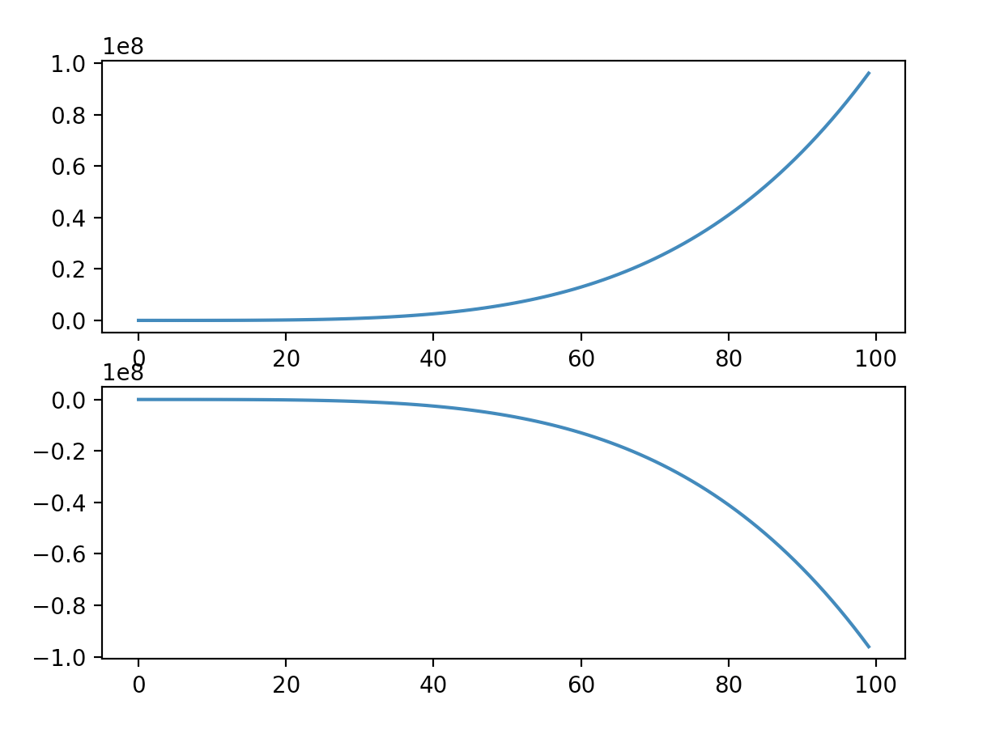
Data Visualization in Python
Perhaps unsurprisingly, Python is an excellent tool for creating visualizations of data. There are many popular packages within Python for doing so; the most ubiquitous is matplotlib. It's what we will be using in this course for creating data visualizations.
The form to the right is two plots contained in a figure.

Slide 21
matplotlib: including
Including matplotlib in your codebase is as easy as importing it.
Don't forget that if you haven't used it in this particular project before, you'll need to install it first! NOTE: Ed stem workspaces already have matplotlib installed!
import matplotlib.pyplot as plt

Slide 22
matplotlib: your first "line"
Let's actually use this package! You're going to want the pyplot module within matplotlib. Typically, this module is given a local name plt.
Now you can access plotting functionality via the plt object. To make a line chart, first "plot" something; then render the result by saving the image (making sure to give it a name!).
And voilà! You are now the proud owner of a new blank plot. Not very exciting … yet.
import matplotlib.pyplot as plt
def main():
# previous code goes here
plt.plot()
plt.savefig('name_of_image.png')
if __name__ == '__main__':
main()

Slide 23
FIGURES AND AXES

Slide 24
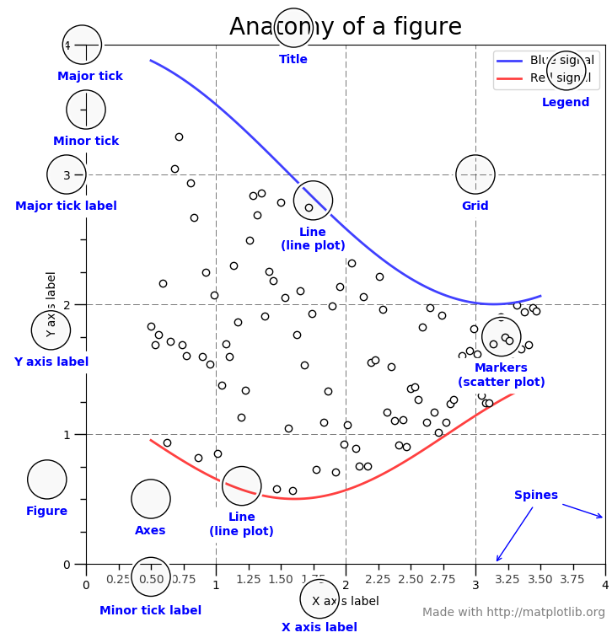
matplotlib: "Anatomy of a Figure"
The picture on the right is a good jumping-off point for understanding the terminology for plot features that matplotlib uses.
source: https://matplotlib.org/examples/showcase/anatomy.html

Slide 25
Figures are the container
When you create a pyplot object, what is actually created is a Figure. That Figure can contain one or more plotting areas; so far you've just been putting one plot inside of every Figure you make.

Slide 26
Axes are the plotting area
Officially, plotting areas in pyplot are called Axes. calling plt.plot() or any other plotting method implicitly and automatically creates a Figure with an Axes inside of it. But you will definitely want more control over what's happening. You might want to create:
multiple Figures, each with a single Axes inside.
a single Figure containing multiple Axes (also known as subplots).
multiple Figures, each containing multiple Axes.

Slide 27
Figure construction: .subplots()
If you want to control the Figure and any of the internal Axes, you'll need a new method. Enter plt.subplots(). This method will return two items to you:
the Figure itself
the collection (actually an ndarray!) of all the internal Axes.
You'll note that this method takes two numeric arguments: the first is the number of rows of Axes you want, and the second is the number of columns.
import matplotlib.pyplot as plt
def main():
data_a = [1, 2, 3, 4]
data_b = [1, 4, 9, 16]
fig, ax = plt.subplots(1, 1)
ax.plot(data_a, data_b)
ax.plot(data_b, data_a)
fig.savefig('figures_are_awesome.png')
if __name__ == '__main__':
main()

Slide 28
Axes: accessing from an array
This is great and all, but what if you want to access more than one subplot? If you give the .subplots() method arguments to create more than one subplot, you can access them like you would access any individual item in an ndarray: via indexing!
import matplotlib.pyplot as plt
def main():
data_a = [1, 2, 3, 4]
data_b = [1, 4, 9, 16]
data_c = [1, 8, 27, 64]
fig, ax = plt.subplots(2, 2)
ax[0, 0].plot(data_a, data_b)
ax[0, 1].plot(data_b, data_a)
ax[1, 0].plot(data_c, data_a)
ax[1, 1].plot(data_b, data_c)
fig.savefig('subplots_are_awesome.png')
if __name__ == "__main__":
main()

Slide 29
matplotlib: style
If you'd like to start with a different visual theme for your plots, you can do so with the plt.style.use() method built into pyplot.
This approach will take a String with a specific style name. But which styles do you have available? why not just do the following!:
print(plt.style.available)
import matplotlib.pyplot as plt
import numpy as np
def main():
plt.style.use('ggplot')
# ...
# previous code goes here
if __name__ == '__main__':
main()

Slide 30
Subplots are the way forward
From here on out, it is required that you solely use the subplots approach to create visualizations. This will mean that you'll only need to use plt in two places:
Creating the Figure and Axes, i.e.:
fig, ax = plt.subplots(<#rows>, <#cols>)
changing the style matplotlib uses:
plt.style.use(<style>)
Everything else can be done directly to the Figure and Axes via their respective methods and attributes!

Slide 31
matplotlib: Axes formatting
There are also many ways to modify the look of your Axes itself. Given that these attributes are a property of the Axes itself, one way to change them is via their respective methods:
.grid(): changes the grid properties (default visible=False)
.set_title(): Axes title (String, default empty)
.set_xlabel(): x-axis label (String, default empty)
.set_ylabel(): y-axis label (String, default empty)
.legend(): adds a legend to the Axes.
import matplotlib.pyplot as plt
import numpy as np
def main():
x = np.arange(0, 100)
y = x + 10*(np.random.rand(x.shape[0])) # add noise
fig, ax = plt.subplots(1, 1)
ax.plot(x, y, linestyle='--', color='g', label='data')
ax.grid(True)
ax.set_title('Babby\'s first line plot')
ax.set_xlabel('x data')
ax.set_ylabel('y data')
ax.legend()
fig.savefig('TAC 216 first plot.png')
if __name__ == '__main__':
main()

Slide 32
matplotlib: changing attributes
Obviously you can change properties of your plots by using the respective methods for each.
matplotlib also provides the set() method, which you can use instead of each individual set methods. You'll just need to feed it keyword arguments which happen to be the same as the methods.
# use this
ax.set_title('my awesome plot')
# or this
ax.set(title='my awesome plot')

Slide 33
matplotlib: plot types
matplotlib has many different plot types, including but not limited to:
line: .plot()
scatter: .scatter()
bar: .bar()
pie: .pie()
histogram: .hist()
It can also do many of these figures in 2D and 3D!

Slide 34
NumPy and matplotlib
Let's immediately contextualize this by combining NumPy with matplotlib.
The result is not quite spectacular yet. But there's some real power here.
import numpy as np
import matplotlib.pyplot as plt
def main():
x = np.arange(0, 10)
y = 2 * x + 6
fig, ax = plt.subplots(1, 1)
ax.plot(x, y)
fig.savefig('linear.png')
if __name__ == "__main__":
main()

Slide 35
NumPy and matplotlib
Remember now NumPy implements quite a bit of mathematical functionality? Let's use some of it to create a trig-based ndarray, and then plot that.
This is much more interesting!
import numpy as np
import matplotlib.pyplot as plt
def main():
x = np.arange(0, 2*np.pi, 0.1)
y = np.sin(x)
fig, ax = plt.subplots(1, 1)
ax.plot(x, y)
fig.savefig('sin.png')
if __name__ == "__main__":
main()

Slide 36
NumPy and matplotlib
Don't forget to label it up!
import numpy as np
import matplotlib.pyplot as plt
def main():
# ...
# previous code goes here
ax.set(xlabel='x', ylabel='y', title='Trig is fun!')
fig.savefig('sin.png')
if __name__ == "__main__":
main()

Slide 37
MORE FIGURE OPTIONS

Slide 38
matplotlib: changing Figure size
Figures themselves have a default size that they will take on. Sometimes, this size is far too small to effectively visualize the data you've plotted. Luckily, the figsize kwarg allows you to change the size of the figure when it is initially constructed.
figsize takes a tuple. Strangely, the dimensions are in inches.
import matplotlib.pyplot as plt
def main():
# 16 inches by 9 inches
fig, ax = plt.subplots(1, 1, figsize=(16, 9))
# rest of code goes here
# ...
if __name__ == "__main__":
main()

Slide 39
Figure construction attributes
When constructing a Figure with more than one subplot inside of it, there are a couple other properties which should be considered:
squeeze: if the subplots are only one-dimensional, pyplot will remove the other dimension so that you only need to index with one number.
sharex and sharey instructs pyplot to use the identical ranges on the x-axis or y-axis, respectively.
import pandas as pd
import matplotlib.pyplot as plt
def main():
file_path = 'iris.csv'
df_iris = pd.read_csv(file_path)
fig, ax = plt.subplots(1, 3, squeeze=False, sharey=True)
ax[0, 0].scatter(df_iris['petal_length'], df_iris['petal_width])
ax[0, 1].scatter(df_iris['sepal_length'], df_iris['petal_width])
ax[0, 2].scatter(df_iris['sepal_width'], df_iris['petal_width])
fig.savefig('iris_petal_scatterplot.png')
if __name__ == '__main__':
main()

Slide 40
Figure layout attributes
Two final notes about Figures:
you may want a title for the entire Figure itself! Use fig.suptitle()
you may find that the subplots aren't spaced well, in which case juse use fig.tight_layout()
import pandas as pd
import matplotlib.pyplot as plt
def main():
# ... previous code goes here
fig.suptitle('Iris data')
fig.tight_layout()
fig.savefig('iris_petal_scatterplot.png')
if __name__ == '__main__':
main()

Slide 41
Summary of terms
Terminology:
ndarray
rank
slice
broadcasting
data visualization
plot types: line, scatter, pie, bar, hist
Figure
Axes
Specific vocab/syntax:
.array()
dtype
.arange()
.ndim
.shape
.reshape()
.stack(), .vstack(), .hstack(), .concatenate()
matplotlib.pyplot module
pyplot.subplots()
Axes plotting
Axes properties (axes and labels, ticks, title, legend, et al.)
Figure properties (suptitle(), tight_layout(), et al.)
pyplot.style.use()
Figure.savefig()

